Slide 1
Designer Fair
Where we assist your Small Business Dreams to come true

Slide 2
Designer fair: an introduction to our company
We are a locally owned and operated business that was started with the purpose and intent to help assist Small Business Owners have a chance to compete with larger corporations by offering them an affordable solution to grow as a company.
Our Business Motto is “Making Small Business Dreams A Reality” because it’s the American Dream to be able to Grow Independently and Freely.

Slide 3
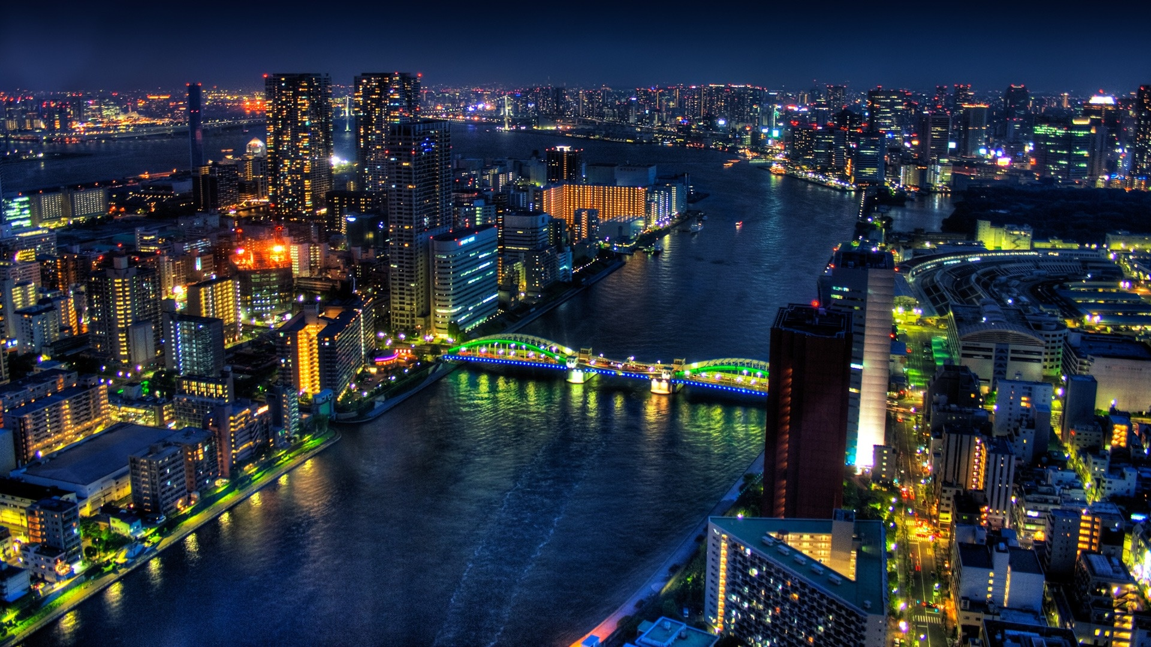
Our goal
Our goal for your small business is simple:
to assist the client in expanding their small business name through marketing and advertising

Slide 4
Our company offers:
Business Consulting
Meet with Clients and evaluate their Businesses needs
List down all ideas and organize into a simple document to be passed on as a project to the Graphic Design Department
Computer Graphic Design Department
Custom Design Jobs such as:
Posters, Brochures, Flyers, Pamphlets, Business Cards and more
Prints out Final job after its been evaluated by the Client and the Business Consultant

Slide 5
photography
Got old cracked photos?
Have a special occasion coming up and need assistance?
Our Graphic Design Department also does Photo Editing, manipulation, and refurnishing.
After a brief consultation the work will be put into our speedy yet quality perfected Refurnishing and Printed up so all your Old cherished photography can look like new again
Our Business Consultant can assist you in putting together anything from Interactive PowerPoint Presentations to Slideshows and Movies
He’ll take down your idea’s and simply pass it to our Graphic Design Department to be perfected and finished for that special occasion

Slide 6
Let us assist you and your company in growing
We offer many incentives and discounts for both new and returning customers. Please feel free to ask your consultant for more information and he will fill you in

